Slide 1


Microsoft® Lync™ 2010
IM and Presence
Training

Slide 2
Objectives
In this course you will learn how to:
Find the right person
Locating someone using incomplete information with Lync 2010
Connect with people you care about
People are easy to get in touch with
Let people know where you are and what you are doing
Share current information using Lync 2010
Stay on top of your daily communication
Easily manage my day-to-day communications with Lync 2010

Slide 3

Finding the Right Person
This section covers the following features:
My Picture and Personal Options
Presence
Hover Experience
Search by Name and/or Keyword
Contact Card
BACK TO OBJECTIVES

Slide 4

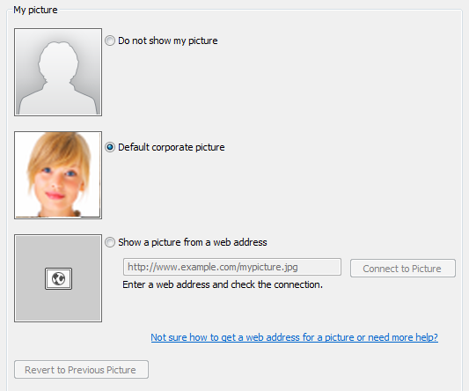
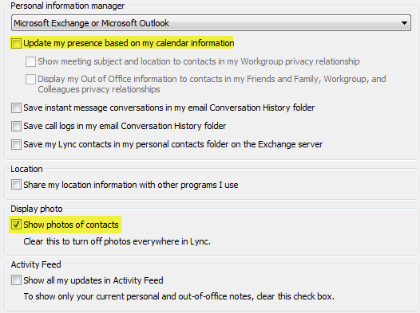
My Picture and Personal Options
Lync provides quick access to setting and updating information a user wants to share. Including a personal note, status, and location.
Personal Note, Status and Location
Change your Personal and My Picture options
Click the Options button to display Options.
Click Personal on the list of options.
Check options to show photos of your contacts and update your presence based on your Microsoft Outlook calendar information.
Click My Picture.
Select which picture you’d like to show or select the option to not show a picture. You can also show a picture from a web address.
Click Ok.
My Picture Options
Personal Options
BACK TO OBJECTIVES

Slide 5
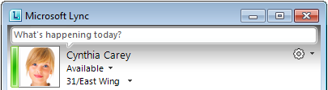
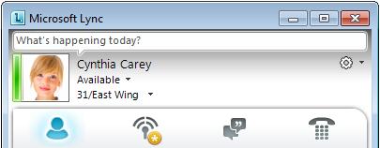
Presence
Personal Note
Options
Lync 2010 automatically sets your presence based on your activity or Outlook calendar. You can also manually update your status.
Photo
Status
Change your Status
Click the presence status and select one of the options.
Location
Available: You are online and available to be contacted.
Busy: You are currently in a call or in a meeting.
Do Not Disturb: By default, you will only see conversation
alerts from Workgroup contacts.
Be Right Back: You are stepping away from the computer for a few moments.
Off Work: You are not working and not available to contact.
Appear Away: Your computer has been idle for a while.
Out of Office: You are out of the office.
Offline: You are not signed in to Lync 2010.
Presence Status
BACK TO OBJECTIVES

Slide 6
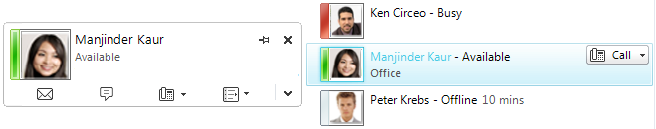
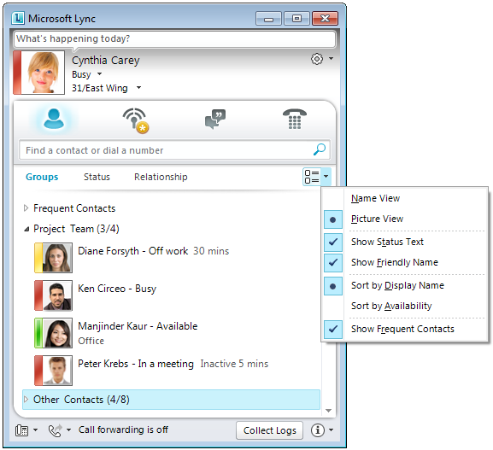
Hover Experience
The Me Area presents photo, status, and other personal information to assist users in identifying a contact. A contact’s picture is a great place to start an IM.
Step 1: Hover
Start an IM with Someone
Point to a person’s picture.
When the contact card opens, click the IM button.
Or
Double-click the contact.
Change Display Options
Click the Display Options arrow.
When the group contact card appears, click the IM button to send a message to the whole group.
Step 2: Click
Display Options:
BACK TO OBJECTIVES

Slide 7
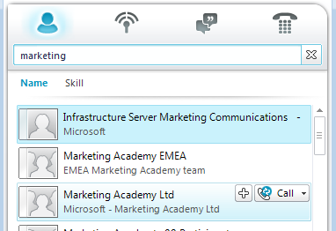
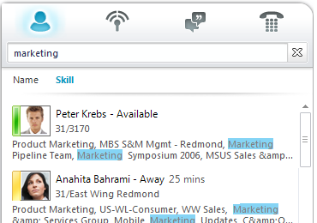
Search by Name/Keyword
Using the enhanced search functionality in Lync 2010, you can quickly identify a person and their availability, get search results that find the right person, and also search on more than just names. Expert Search uses keywords to narrow the search for finding a person or group with specific attributes.
Search Criteria
Search for a Person
Type a person’s name in the search box.
Results appear below the box.
Search for an Expert
Type a keyword to narrow the search for finding someone with specific attributes. You can also just click the Skill tab to view Keyword-based results for your search.
Results appear with your search criteria highlighted.
Skill Results
BACK TO OBJECTIVES

Slide 8
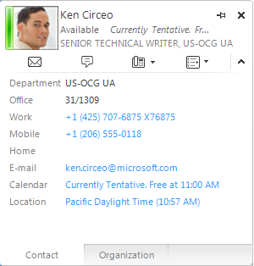
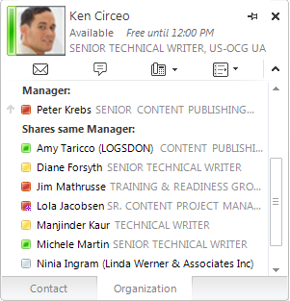
Contact Card
The contact card is an ever-present tool for viewing someone’s profile and organizational information.
The contact card also serves as launch point for communication with a person or group.
View a Contact Card
Hover over a person’s picture to display their contact card.
Click the chevron (^) for a full version of their contact card.
To see their organization, click Organization.
Contact Information
Organization Information
BACK TO OBJECTIVES

Slide 9
Activity 1: Find a Contact and Start and IM
Type a person’s name in the search box.
Point to the person’s picture.
When the contact card opens, click the IM button.
Question: What is an alternate way to start an IM?
BACK TO OBJECTIVES

Slide 10
Connecting with People
This section covers the following features:
Frequent Contacts
Action Bar for Multimodal
Communication
BACK TO OBJECTIVES

Slide 11
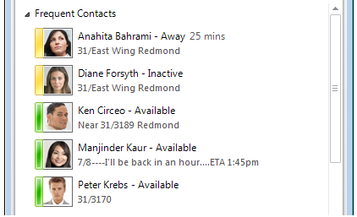

Frequent Contacts
Frequent Contacts simplifies contact management by giving users easier access to favorite contacts. Lync 2010 automatically populates the Frequent Contacts group based on recent conversations, but you can pin a few of your most important contacts to this group for quick access.
Frequent Contacts
View Frequent Contacts
Click the chevron next to Frequent Contacts.
Pin Frequent Contacts
Type the person’s name or e-mail address in the search box.
In the search results, right-click the person, and then click Pin to Frequent Contacts.
TIP: You can show or hide your Frequent Contacts using the display options menu.
Pin Contact
BACK TO OBJECTIVES

Slide 12
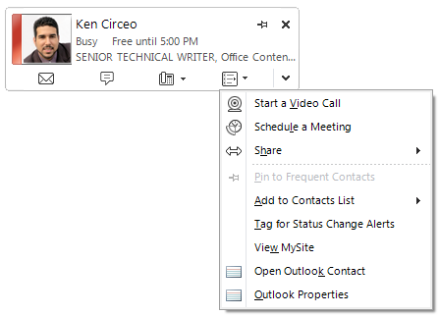
Action Bar for Multimodal Communication
The Action bar allows users to intuit what Lync 2010 provides and easily allows them to decide how to contact someone. You can send an e-mail message, or start an IM or a phone call. You can also choose more options like a video call, schedule a meeting, or share content.
Use the Action Bar
Hover over a contact.
Click any icon on the action bar to initiate communication with the contact.
Click the More Options icon to see additional options for communicating with this contact.
More Options
Email
IM
Phone
BACK TO OBJECTIVES

Slide 13
Activity 2: Discover the Action Bar
Hover over a contact.
Click any icon on the action bar to initiate communication with the contact.
Click the More Options icon to see additional options for communicating with this contact.
BACK TO OBJECTIVES

Slide 14
Let People Know Where You Are
This section covers the following features:
Location
Personal Note
Activity Feed
BACK TO OBJECTIVES

Slide 15
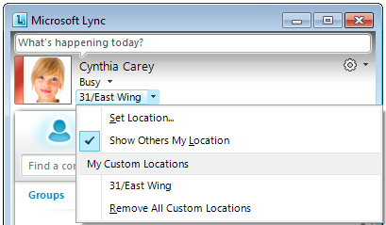
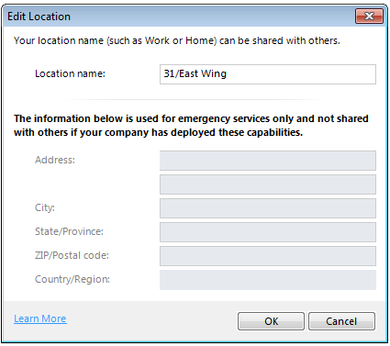
Location
Lync 2010 displays a location under your presence status that is related to the network you’re connected to. You can make this location more meaningful by renaming it “Work” or “Home.” Then, every time you’re working from this location, any contacts you want to let know will have a better idea of where you are.
Location
Set your Location
Click the Set Your Location arrow. Select a location.
Create a Custom Location
Click the Set Your Location arrow.
Click Set Your Location.
Type your location name in the Edit Location window.
Click OK.
911 Location
TIP: 911 Location information can be
used by emergency services.
BACK TO OBJECTIVES

Slide 16

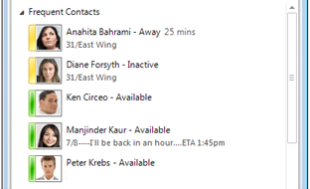
Personal Note
Lync 2010 let you easily update your location and note. You know at a glance what others are seeing about you so you can make sure your information is accurate and up-to-date. Your personal note is displayed as the second line of your contact information when other people view your contact information in Lync 2010.
Update your Personal Note
Click in the Personal Note area.
Type your note.
You can also include a hyperlink.
Personal Note
BACK TO OBJECTIVES

Slide 17
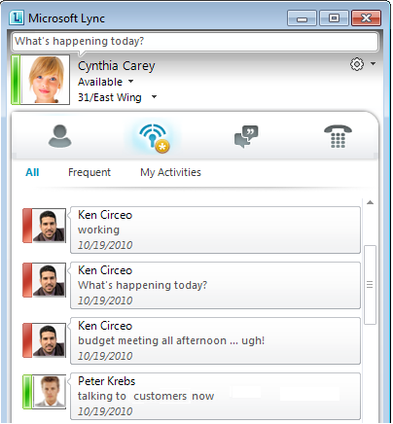
Activity Feeds
Activity Feeds provide a single view to monitor real-time updates of shared information.
TIP: If you pin your contacts – you can use Frequent in feeds to view only pinned contacts in your feed.
Feeds
Few your Feeds
Click the Feeds tab.
Scroll through available feeds.
Monitoring
BACK TO OBJECTIVES

Slide 18
Activity 3: Update Your Personal Note
Click in the Personal Note area.
Type your note.
Update your note.
Challenge: Include a hyperlink in your Personal Note. Invite a contact to view your personal note and click the hyperlink.
BACK TO OBJECTIVES

Slide 19
Stay on Top of Communications
This section covers the following features:
Notifications
Windows 7 Integration
Managing Conversations
BACK TO OBJECTIVES

Slide 20

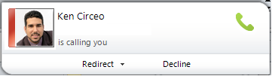
Notifications
There are four areas that allow you to organize and easily view information about your contacts. Features like notifications allow you to stay on top of past and present conversations, know when someone is trying to get in touch, and easily manage your active conversations. Notifications surface communication activity from your contacts.
View Notifications
Click Activity Feeds, conversations, or Phone to view recent activity, conversations, calls and voicemails.
Contacts
Activity Feeds
Conversations
Phone
Call Notification
BACK TO OBJECTIVES

Slide 21
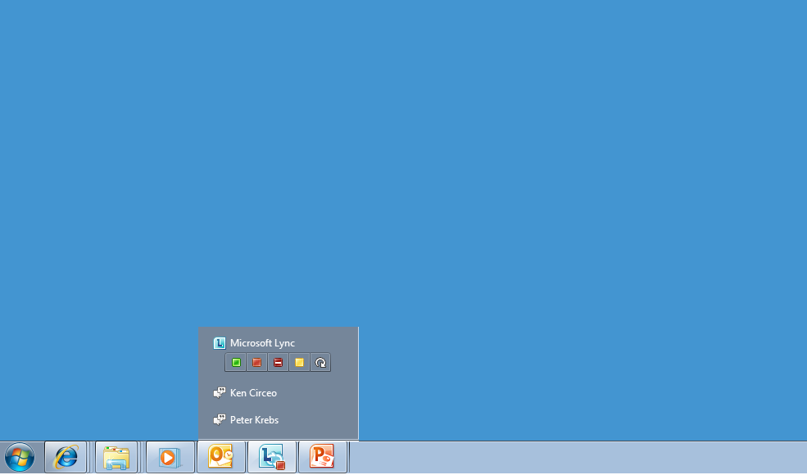
Windows 7 Integration
With Windows 7 integration, you can hover over the Lync 2010 icon in the task bar to change your status and view and manage conversations.
Change Status
Navigate through active conversations
BACK TO OBJECTIVES

Slide 22
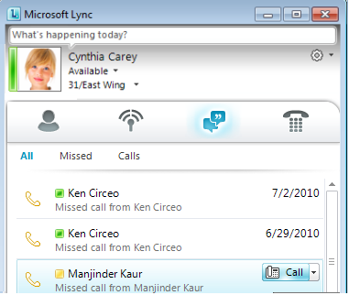
Managing Conversations
The Conversation area allows you to stay on top of past and present conversations. You can navigate through open conversations or view past conversations without leaving Lync.
Manage Conversations
Click the Conversations Environment tab.
Scroll through the list of current and past conversations.
Conversations
BACK TO OBJECTIVES

Slide 23
Activity 4: Manage Multiple Conversations
Use the Conversations Environment tab to view current and past conversations.
Hover over the Lync 2010 icon in the task bar to view current conversations.
Switch between conversations.
BACK TO OBJECTIVES

Slide 24
Review
This course covered the following topics:
Find the right person
Locating someone using incomplete information with Lync 2010
Connect with people you care about
People are easy to get in touch with
Let people know where you are and what you are doing
Share current information using Lync 2010
Stay on top of your daily communication
Easily manage my day-to-day communications with Lync 2010
BACK TO OBJECTIVES

Slide 25


© 2010 Microsoft Corporation. All rights reserved. Microsoft, Exchange ActiveSync, Excel, Lync, Outlook, PowerPoint, SharePoint, SQL Server, Windows, Windows Live, Windows Mobile, Windows Server, and other product names are or may be registered trademarks and/or trademarks in the United States and/or other countries/regions. The information herein is for informational purposes only and represents the current view of Microsoft Corporation as of the date of this presentation. Because Microsoft must respond to changing market conditions, it should not be interpreted to be a commitment on the part of Microsoft, and Microsoft cannot guarantee the accuracy of any information provided after the date of this presentation. MICROSOFT MAKES NO WARRANTIES, EXPRESS, IMPLIED OR STATUTORY, AS TO THE INFORMATION IN THIS PRESENTATION.
BACK TO OBJECTIVES

